Slide 1

Python Day 2

Slide 2
Objectives
What is a loop
For loop
While loop
Infinite loop
If/Elif/Else
Loop keywords (break/continue)
Exercises on loops and conditions

Slide 3
Objectives
Defining a function
Arguments
Variable-length arguments
Return statement
Recursion
Lambda Function
Exercises on functions

Slide 4
1-Why do we need lists and loops?
In programming:
lists used to store sequences of related data and to perform the same operation on every element in a list, like displaying each element or manipulating them mathematically.
The loop used to iterate over each element we stored in a list, repeating the same code for each element.
Notes:
A very common situation in biological research is to have a large collection of data (DNA sequences, SNP positions, gene expression measurements) that all need to be processed in the same way.
In programming, lists used to store sequences of related data and to perform the same operation on every element in a list, like displaying each element or manipulating them mathematically.
The loop used to iterate over each element we stored in a list, repeating the same code for each element.

Slide 5

1-1 Deal with large datasets
A very common situation in biological research is to have a large collection of data (DNA sequences, SNP positions, gene expression measurements) that all need to be processed in the same way.

Slide 6
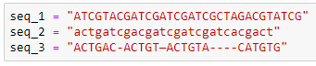
1-2 When we've needed to store multiple bits of information
for example, the three DNA sequences as below

Slide 7
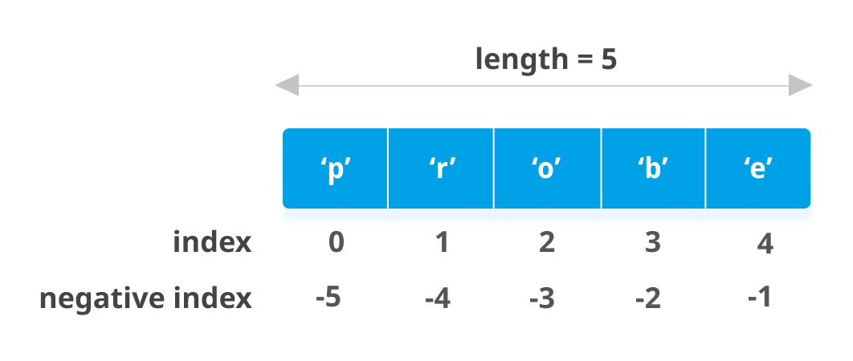
1-3 list
A list (also called an array in other programming languages) is a tool that can be used to store multiple pieces of information at once.
It can also be defined as a variable containing multiple other variables.

Slide 8
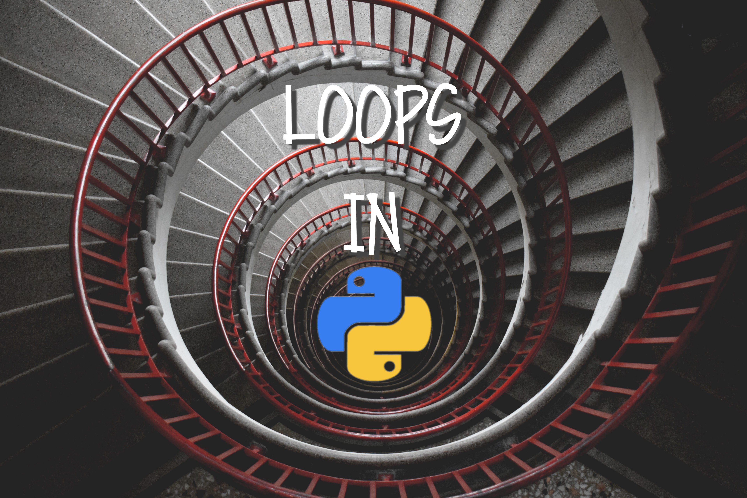
1-4 loop
Is a sequence of instructions that is continually repeated until a certain condition is reached.

Slide 9
3- Writing a loop

Slide 10
We have the following list
We need to print it as:
Homo sapiens is an ape
Pan troglodytes is an ape
Gorilla gorilla is an ape

Slide 11
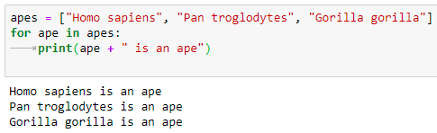
Solution

Slide 12
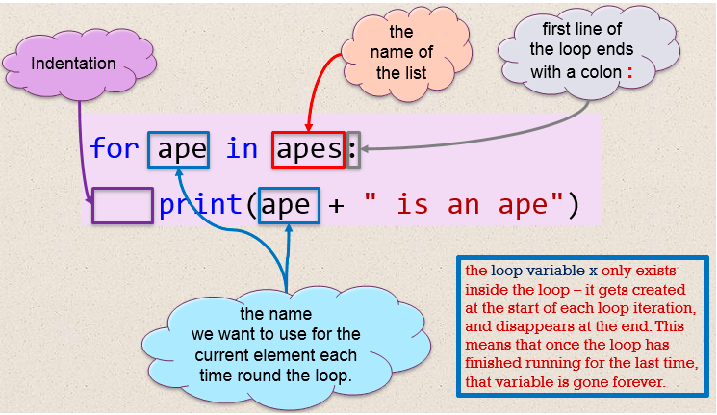

Slide 13
3-1 Iterating over lines in a file
When we treat a string as a list, each character becomes an individual element,
But
When we treat a file as a list, each line becomes an individual element.

Slide 14
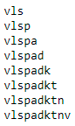
3-1 Iterating over lines in a file - Example
we have the protein = "vlspadktnv" and we need to print it as
vls vlsp vlspa vlspad ...etc...

Slide 15
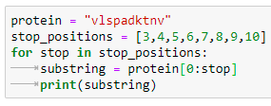
Solution

Slide 16
4- Conditions, True and False

Slide 17
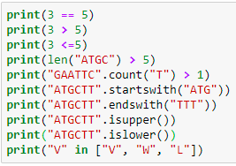

Slide 18
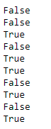

Slide 19
5- If Statement

Slide 20
If statement
if statement: Executes a group of statements only if a certain condition is true. Otherwise, the statements are skipped.
Syntax:
if condition:
statements

Slide 21
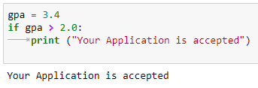
If statement (Example -1)

Slide 22
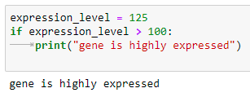
If statement (Example -2)

Slide 23
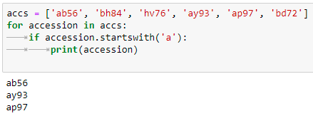
If statement (Example -3) List - Loop - If statement example

Slide 24
If/Else Statement
if/else statement: Executes one block of statements if a certain condition is True, and a second block of statements if it is False.
Syntax:
if condition:
statements
else:
statements

Slide 25
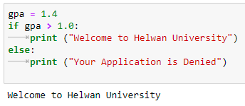
If/Else Statement (Example)

Slide 26
Exercise
Ask about the temperature degree. If it is greater than 35 degree, then wear shorts if not wear long pants

Slide 27
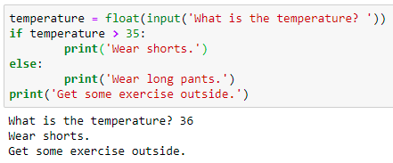
Exercise (solution)
Ask about the temperature degree. If it is greater than 35 degree, then wear shorts if not wear long pants

Slide 28
Multiple conditions elif ("else if")
if/else statement: Executes one block of statements if a certain condition is True, and a second block of statements if it is False.
Syntax:
if condition:
statements
elif condition:
statements
else:
statements

Slide 29
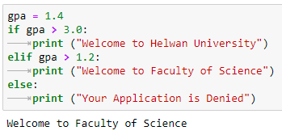
Multiple conditions elif ("else if") - Example

Slide 30
6- While loop

Slide 31
While loop
while loop: repeatedly executes a target statement as long as a given condition is true.
Syntax:
while expression:
statement(s)

Slide 32
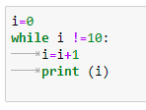
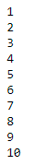
While loop (Example)

Slide 33

Infinite Loops
Every while loop needs a way to stop running so it won’t continue to run forever.

Slide 34
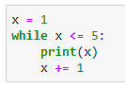
Infinite Loops (Example)
this counting loop should count from 1 to 5:

Slide 35
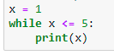
Infinite Loops (Example)
But if you accidentally omit the line x += 1 (as shown in pervious example), the loop will run forever:
Notes:
You can terminate the code by Ctrl+C, which generates an interrupt from the keyboard. Otherwise, it would have gone on unendingly
Now the value of x will start at 1 but never change. As a result, the conditional test x <= 5 will always evaluate to True and the while loop will run forever, printing a series of 1s.
If your program gets stuck in an infinite loop, press ctrl-C or just close the terminal window displaying your program’s output.

Slide 36
7- Exit a Loop with break keyword

Slide 37
The break Statement
The break statement, when it occurs within a for loop, or while loop, causes the loop to terminate immediately and program execution continues with the statement after the loop

Slide 38
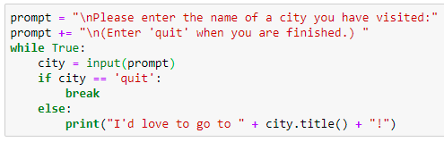
The break Statement (Example - 1)

Slide 39
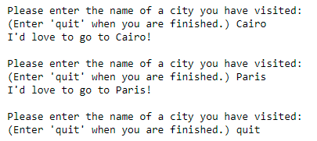
The break Statement (Example - 1)

Slide 40
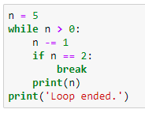
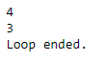
The break Statement (Example - 2)

Slide 41
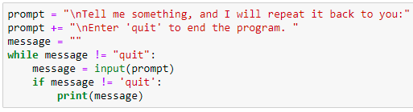
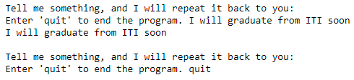
The break Statement (Example - 3)
Notes:
Break
Without using break word

Slide 42
The continue Statement
The continue statement, when it occurs within a for loop, a while loop, or a do-while loop, causes the program execution to jump to the bottom of the loop.
None of the statements between the continue statement and the bottom of the loop are executed. The loop then continues as normal.

Slide 43
The continue Statement (Example)
consider a loop that counts from 1 to 10 but prints only the odd numbers in that range

Slide 44
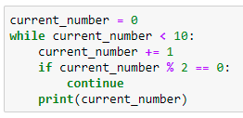
The continue Statement (Example - Soln)

Slide 45
number = 0
for number in range(10):
if number == 5:
break
print('Number is ' + str(number)) print('Out of loop')
Output
Number is 0
Number is 1
Number is 2
Number is 3
Number is 4
Out of loop
Break
number = 0
for number in range(10):
if number == 5:
continue
print('Number is ' + str(number)) print('Out of loop')
Output
Number is 0 Number is 1 Number is 2 Number is 3 Number is 4 Number is 6 Number is 7 Number is 8 Number is 9
Out of loop
Continue
Pass
number = 0
for number in range(10):
if number == 5:
pass
print('Number is ' + str(number)) print('Out of loop')
Output
Number is 0 Number is 1 Number is 2 Number is 3 Number is 4 Number is 5 Number is 6 Number is 7 Number is 8 Number is 9 Out of loop

Slide 46
One-Line while Loops
A while loop can be specified on one line. If there are multiple statements in the block that makes up the loop body, they can be separated by semicolons (;):

Slide 47
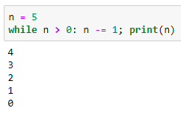
One-Line while Loops (Example)

Slide 48
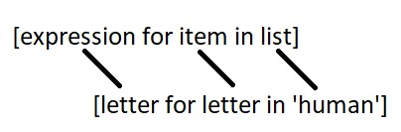
List Comprehension
Syntax
h_letters = []
for letter in 'human’:
h_letters.append(letter) print(h_letters)
['h', 'u', 'm', 'a', 'n']
h_letters = [ letter for letter in 'human’ ]
print( h_letters)

Slide 49
Defining a function

Slide 50
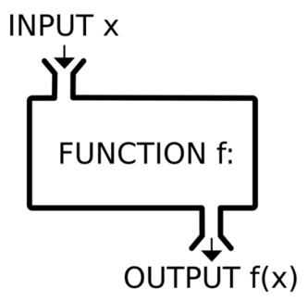
Introduction to functions in python
Function in any programming language is a sequence of statements in a certain order, given a name.
When called, those statements (function) are executed.
So, we don’t have to write the code again and again for each [type of] data that we want to apply it to.

Slide 51
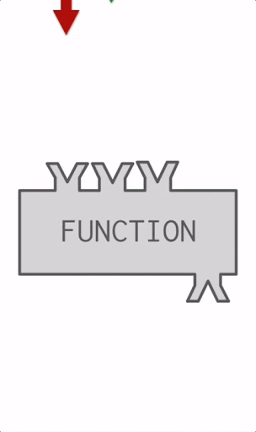
Introduction to functions in python (cont.)
In another words
A function is a block of code which only runs when it is called.
You can pass data, known as arguments, into a function.
A function can return data as a result.

Slide 52
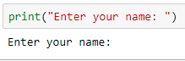
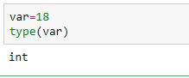
Types of Function
Built-in functions
User-define function
Will discussed in this session

Slide 53
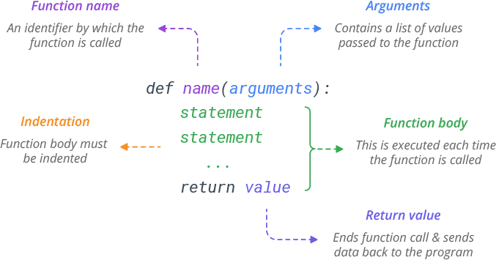
Function syntax in python

Slide 54
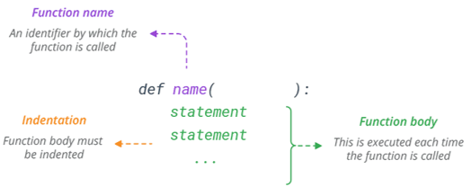
Define function
In Python a function is defined using the def keyword:

Slide 55
Call a Function
The def statement only creates a function but does not call it.
After the def has run, you can call (run) the function by adding parentheses after the function’s name.
Function definition
def my_function():
Function call
my_function()

Slide 56
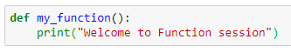
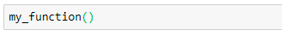
Example
Function definition
Function call
Output

Slide 57
Workshop 01
Create a function that print your full name, your age and your collage.
Then call a function at the body of your code

Slide 58
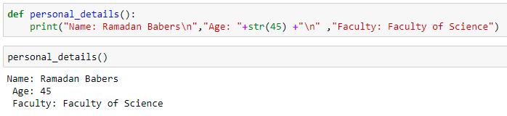
Workshop 01 - Solution

Slide 59
Arguments

Slide 60
Arguments
Pass Arguments
You can send information to a function by passing values, known as arguments. Arguments are declared after the function name in parentheses.
When you call a function with arguments, the values of those arguments are copied to their corresponding parameters inside the function.

Slide 61
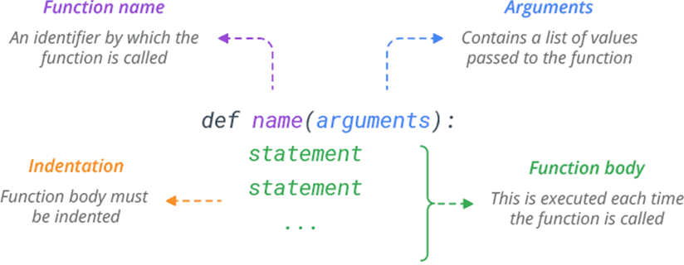
Arguments (cont.)

Slide 62
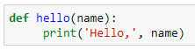
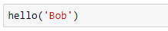
Example
Function definition
Function call
Output

Slide 63
Arguments types
Non-default Arguments
Default Arguments
Keyword Arguments
Variable-length Arguments
Arguments types

Slide 64
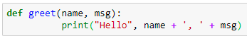
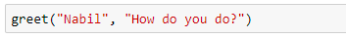
1. Non-default Arguments
Function arguments can have no default values in function define section.

Slide 65
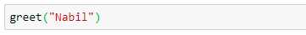
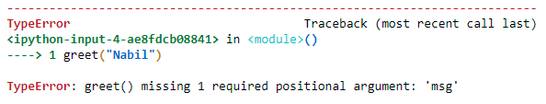
1. Non-default Arguments (cont.)
?

Slide 66
Workshop 02
Create a function that print your full name, your age and your collage by using Non-default arguments

Slide 67
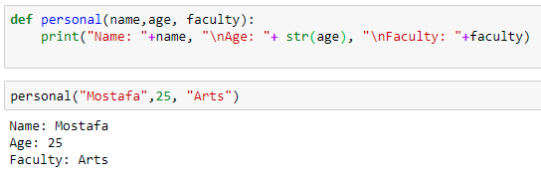
Workshop 02 - Solution

Slide 68
Workshop 03
Write a Python program to print the even numbers from a given list
Sample List : [1, 2, 3, 4, 5, 6, 7, 8, 9] Expected Result : [2, 4, 6, 8]

Slide 69
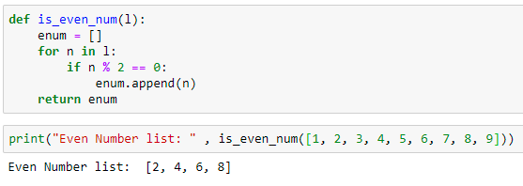
Workshop 03 - Solution

Slide 70
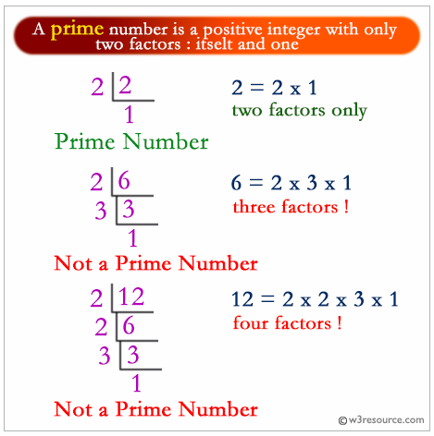
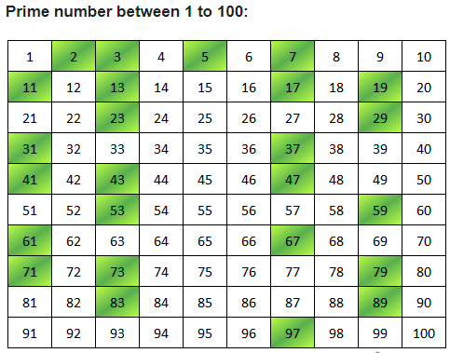
Exercise 01
Write a Python function that takes a number as a parameter and check the number is prime or not

Slide 71
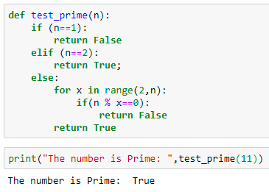
Exercise 01 - Solution

Slide 72
Exercise 02
Write a Python function to calculate the factorial of a number (a non-negative integer). The function accepts the number as an argument

Slide 73
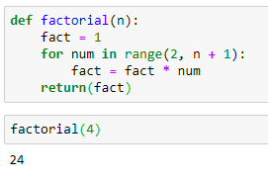
Exercise 02 - Solution

Slide 74


2. Default Arguments
Function arguments can have default values in function define section.
We can provide a default value to an argument by using the assignment operator (=).

Slide 75


2. Default Arguments (cont.)
?

Slide 76


2. Default Arguments (cont.)
Is it possible to do that ?

Slide 77
Workshop 04
Create a function showEmployee() in such a way that it should accept employee name, and it’s salary and display both, and if the salary is missing in function call it should show it as 9000

Slide 78

Workshop 04 - Solution

Slide 79
3. Keyword Arguments / named Arguments
Keyword arguments are passed by it’s name instead of their position as opposed to positional arguments in the function call.
As a result we don’t have to mind about position of arguments when calling a function.

Slide 80



3. Keyword Arguments / named Arguments (cont.)

Slide 81


3. Keyword Arguments / named Arguments (cont.)
1positional, 1 keyword argument

Slide 82
4. Variable Length Arguments (*args and **kwargs)
Variable length arguments are useful when you want to create functions that take unlimited number of arguments.
Unlimited in the sense that you do not know beforehand how many arguments can be passed to your function by the user.

Slide 83
4. Variable Length Arguments (*args and **kwargs) (cont.)
*args
When you prefix a parameter with an asterisk * , it collects all the unmatched positional arguments into a tuple.
Because it is a normal tuple object, you can perform any operation that a tuple supports, like indexing, iteration etc.

Slide 84

4. Variable Length Arguments (*args and **kwargs) (cont.)
Following function prints all the arguments passed to the function as a tuple.

Slide 85
4. Variable Length Arguments (*args and **kwargs) (cont.)
**kwargs
The ** syntax is similar, but it only works for keyword arguments.
It collects them into a new dictionary, where the argument names are the keys, and their values are the corresponding dictionary values.

Slide 86

4. Variable Length Arguments (*args and **kwargs) (cont.)

Slide 87


Workshop 05
Write a function func1() such that it can accept a variable length of argument and print all arguments value

Slide 88

Workshop 05 - Solution

Slide 89
Return Statements

Slide 90
Return Value
To return a value from a function, simply use a return statement.
Once a return statement is executed, nothing else in the function body is executed.
Notes:
يعنى أى حاجة بعد السطر اللى مكتوب فيه return مش هيحصله حاجة – مش هيتنفذ

Slide 91


Return Value (cont.)

Slide 92


Return Value (cont.)
Note: a python function always returns a value. So, if you do not include any return statement, it automatically returns None.

Slide 93



Return Multiple Values
Python can return multiple values, something missing from many other languages. You can do this by separating return values with a comma.

Slide 94



Return Multiple Values (cont.)
When you return multiple values, Python packs them in a single tuple and returns it.
You can then use multiple assignment to unpack the parts of the returned tuple.

Slide 95

Workshop 06
Write a function calculation() such that it can accept two variables and calculate the addition and subtraction of it. And also it must return both addition and subtraction in a single return call

Slide 96


Workshop 06 – Solution

Slide 97
Recursion

Slide 98

Recursion
A recursive function is a function that calls itself and repeats its behavior until some condition is met to return a result.

Slide 99



Recursion - Example
countdown() is a recursive function that calls itself (recurse) to countdown.
If num is 0 or negative, it prints the word “Stop”.
Otherwise, it prints num and then calls itself, passing num-1 as an argument.

Slide 100
Workshop 07
Write a recursive function to calculate the sum of numbers from 0 to 10

Slide 101


Workshop 07 - Solution

Slide 102
Lambda Functions

Slide 103

Lambda Functions
In Python, an anonymous function means that a function is without a name.
As we already know that the def keyword is used to define a normal function in Python.
Similarly, the lambda keyword is used to define an anonymous function in Python.
Syntax: lambda arguments: expression

Slide 104
Lambda Functions (cont.)
This function can have any number of arguments but only one expression, which is evaluated and returned.
One is free to use lambda functions wherever function objects are required.
You need to keep in your knowledge that lambda functions are syntactically restricted to a single expression.
It has various uses in particular fields of programming besides other types of expressions in functions.

Slide 105


Lambda Functions (Example)
Cube Number
def()
lambda()

Slide 106
THANKS!
ANY QUESTIONS?

